Slide 1
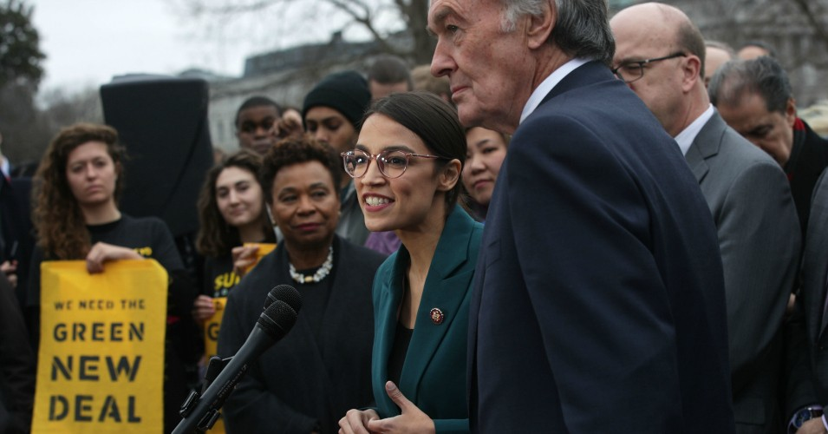
A Green New Deal

Slide 2
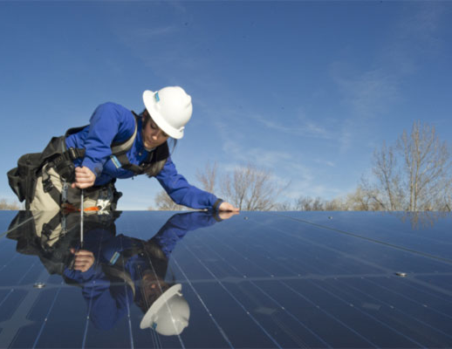
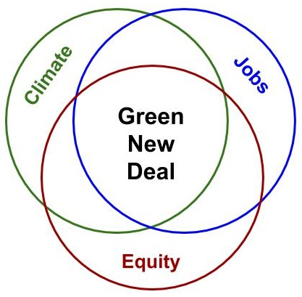
3: Three pillars of a Green New Deal
Tackling the climate crisis and toxic pollution
Creating good, high-paying jobs
Fighting racial, economic, and gender inequity

Slide 3
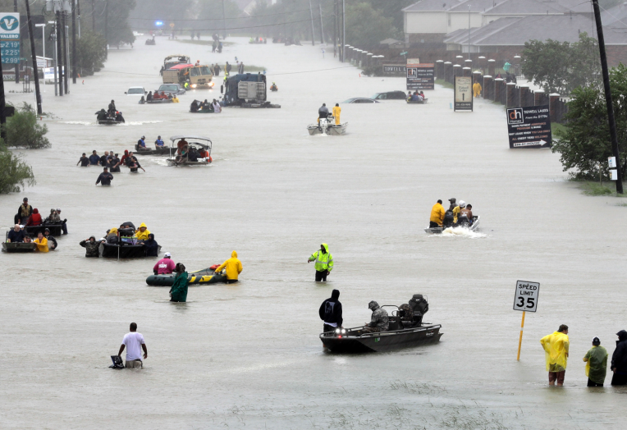
2: Two linked crises: Climate & inequity

Slide 4
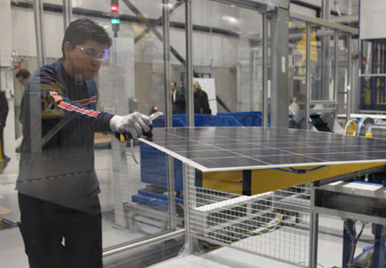
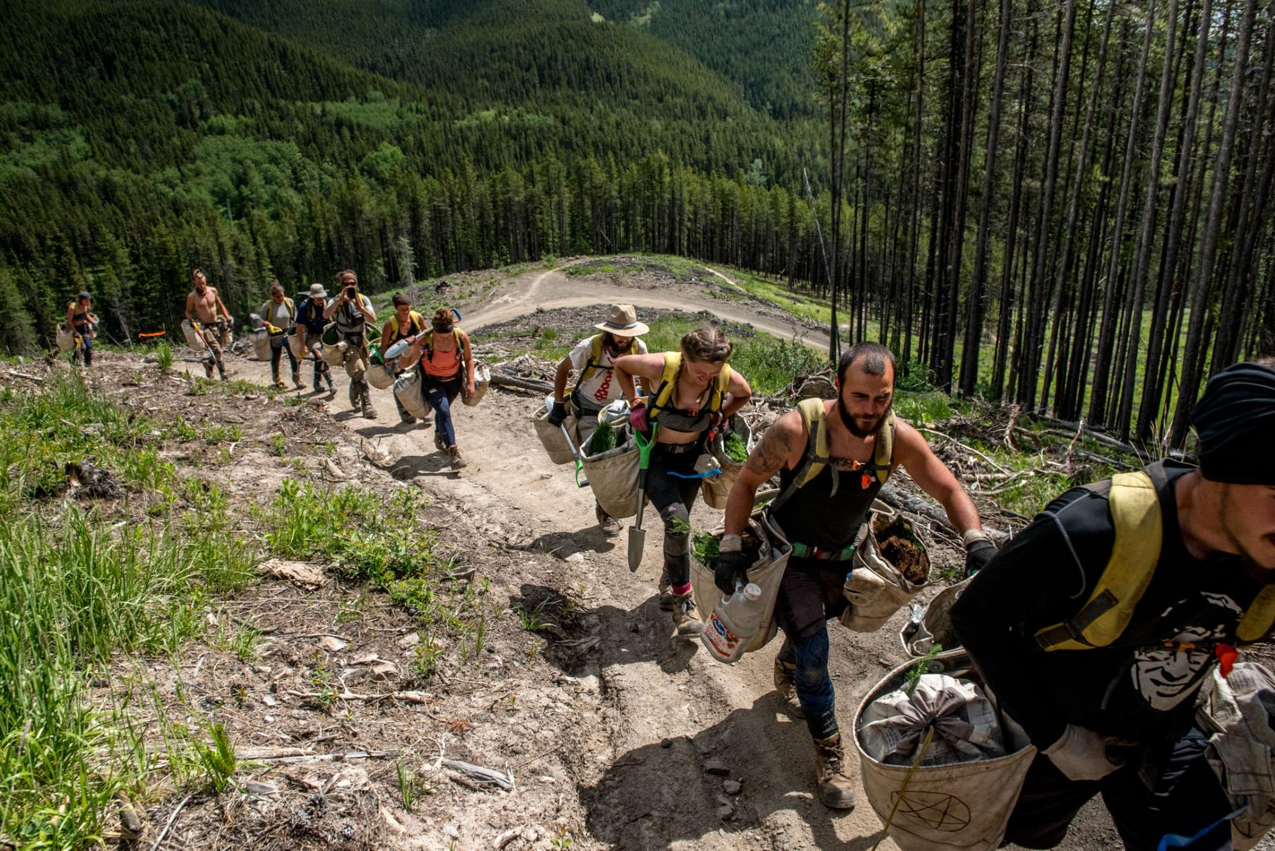
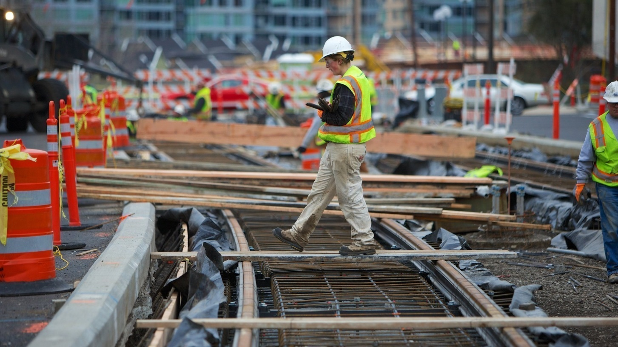
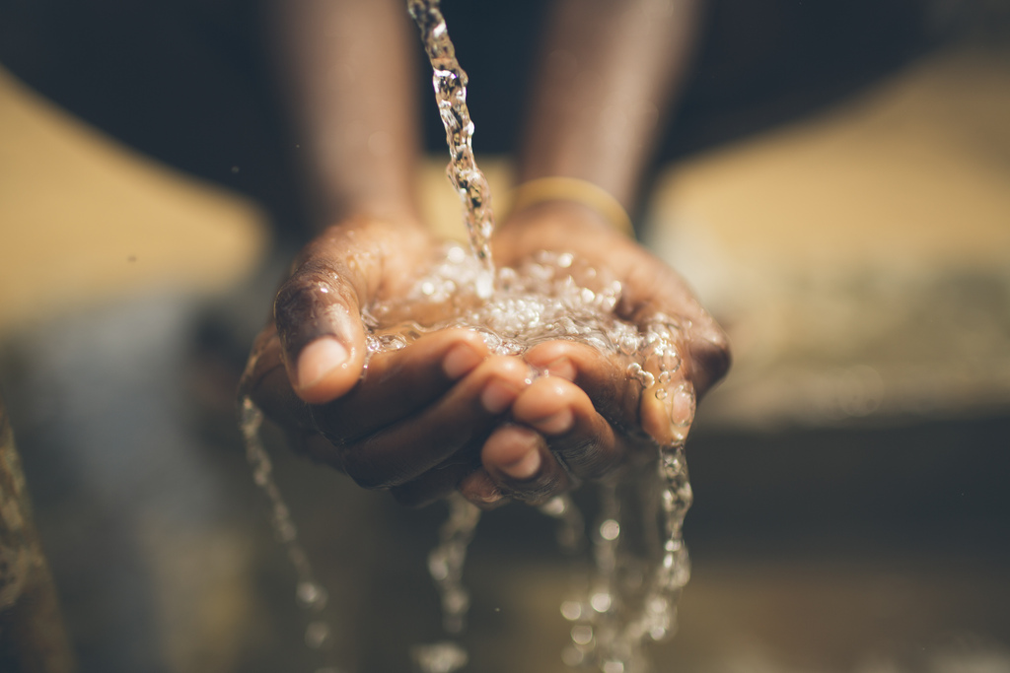
1: One big deal

Slide 5
GND resolution: Goals
Climate/pollution: --“net-zero greenhouse gas emissions” --“a fair and just transition for all communities and workers” --“clean air and water, climate and community resiliency, healthy food, access to nature, and a sustainable environment” for all
Jobs: --“millions of good, high-wage jobs” --“prosperity and economic security for all”
Equity: --“stopping current, preventing future, and repairing historic oppression of indigenous peoples, communities of color, migrant communities, deindustrialized communities, depopulated rural communities, the poor, low-income workers, women, the elderly, the unhoused, people with disabilities, and youth”

Slide 6
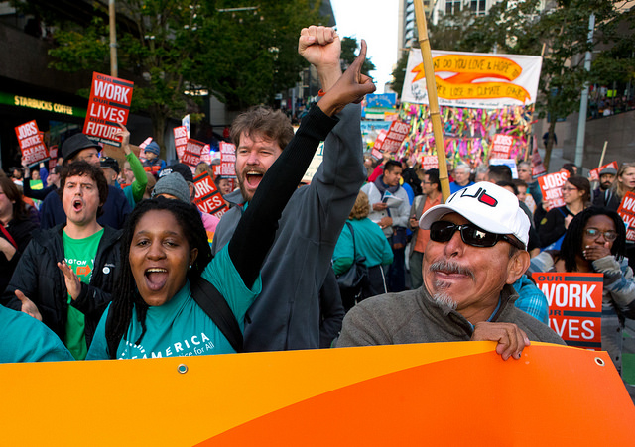
Building alignment and momentum
Laying the groundwork for policy change: Compelling vision + press momentum + growing coalition + congressional support

Slide 7
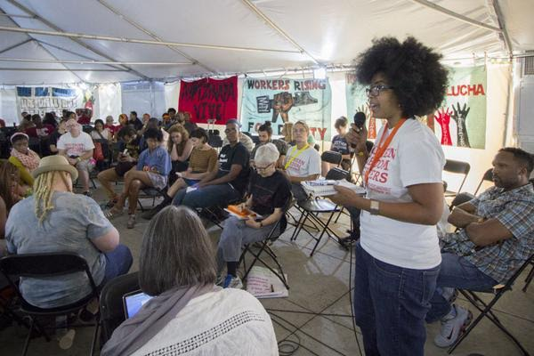
Inclusive process → Inclusive economy

Slide 8
GND policy ideas
100% clean energy
Infrastructure renewal:
Reduce climate impacts
Ensure clean water
Expand clean transportation
Weatherize all buildings
Massive growth in clean manufacturing
Restore ecosystems and clean up hazardous waste

Slide 9
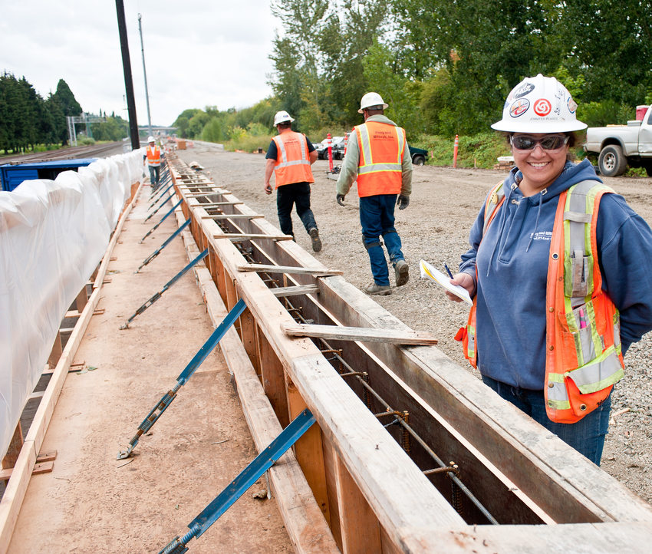
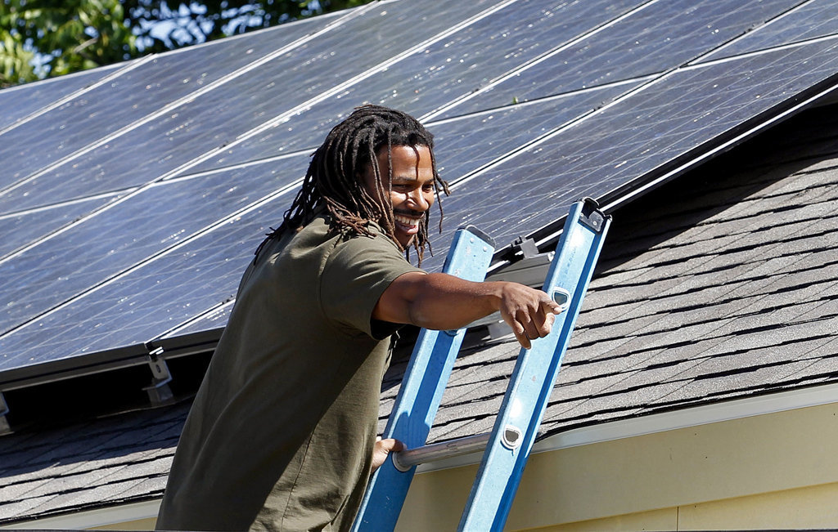
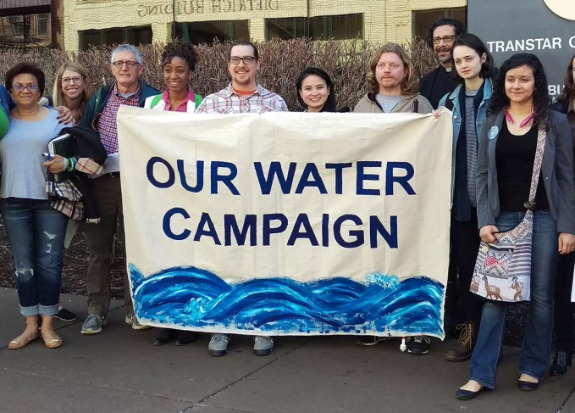
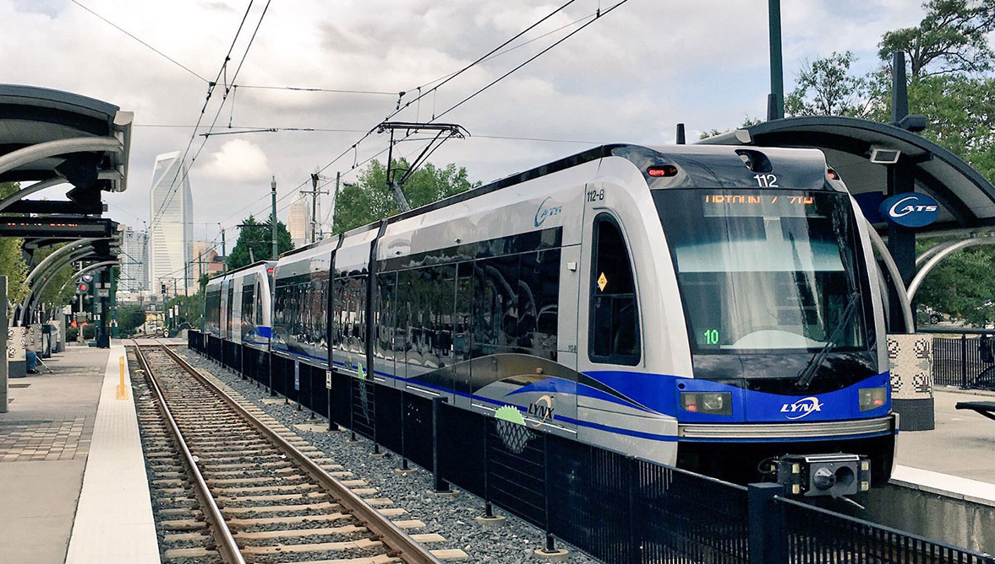
Infrastructure renewal

Slide 10
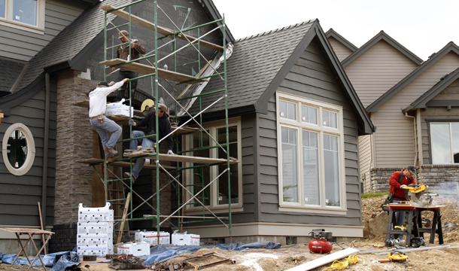
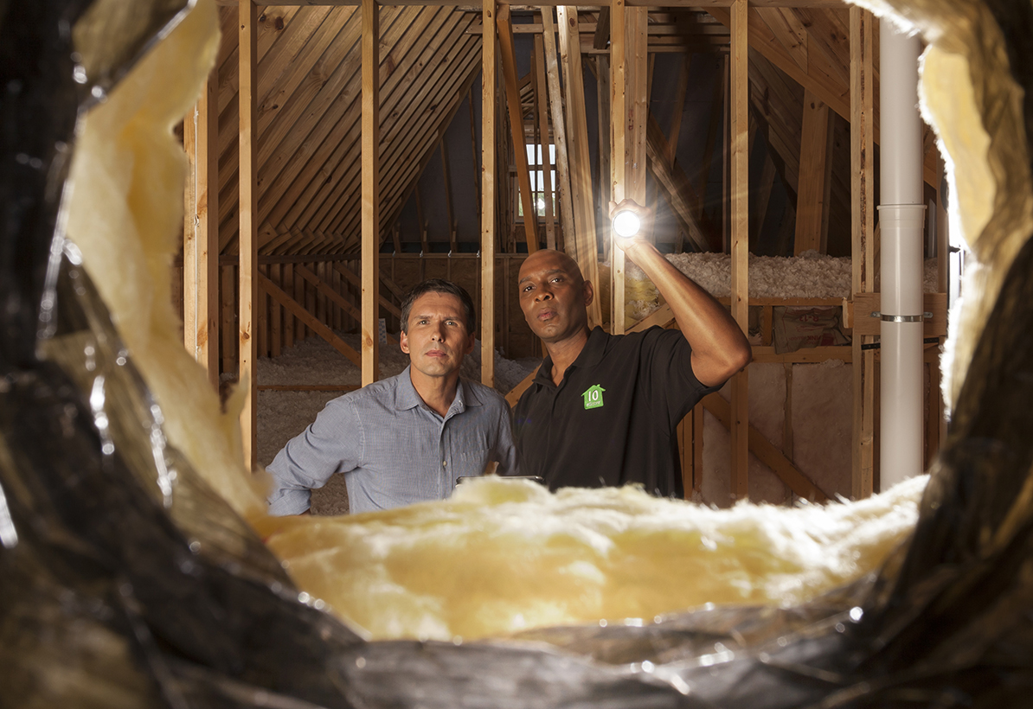
Weatherize America

Slide 11
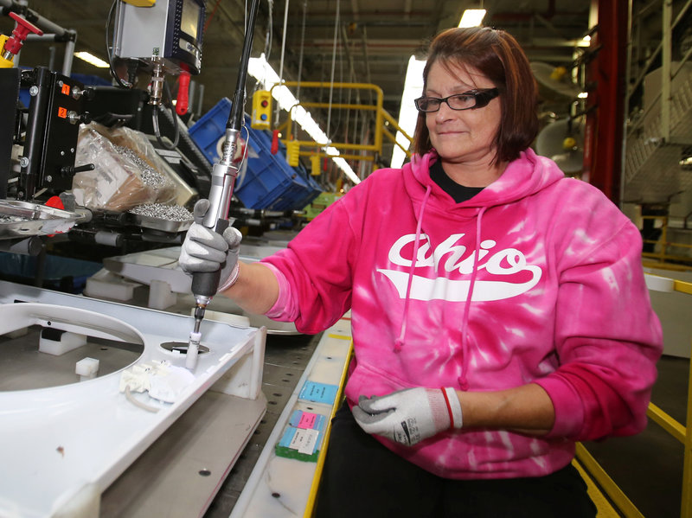
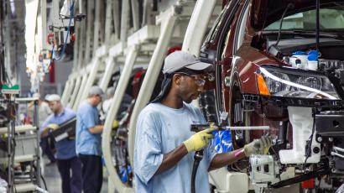
Clean manufacturing revolution

Slide 12
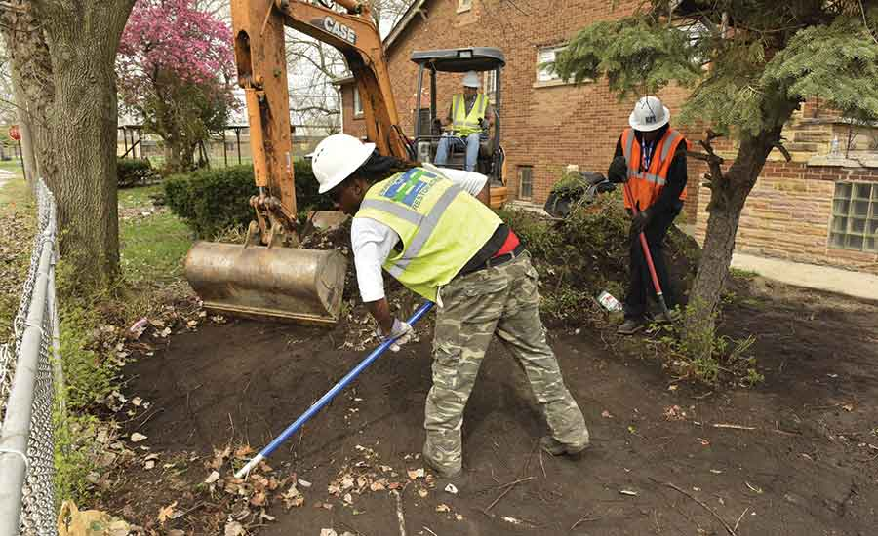
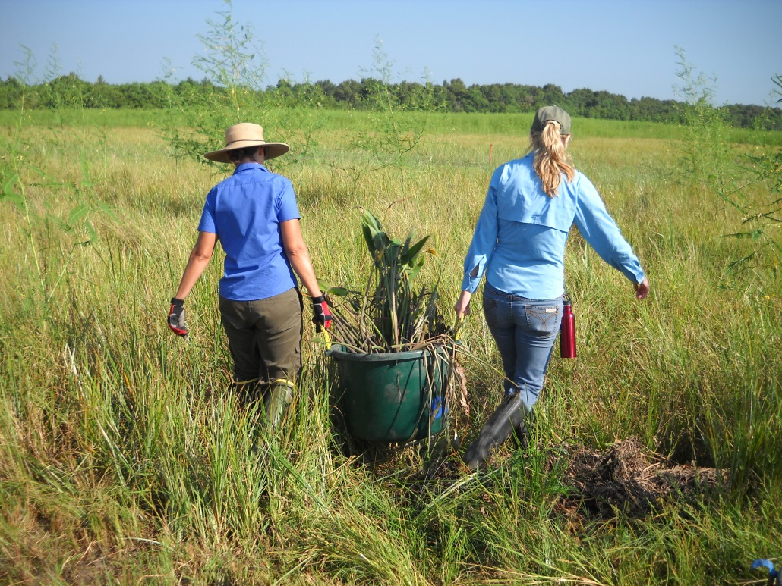
Green brigades

Slide 13
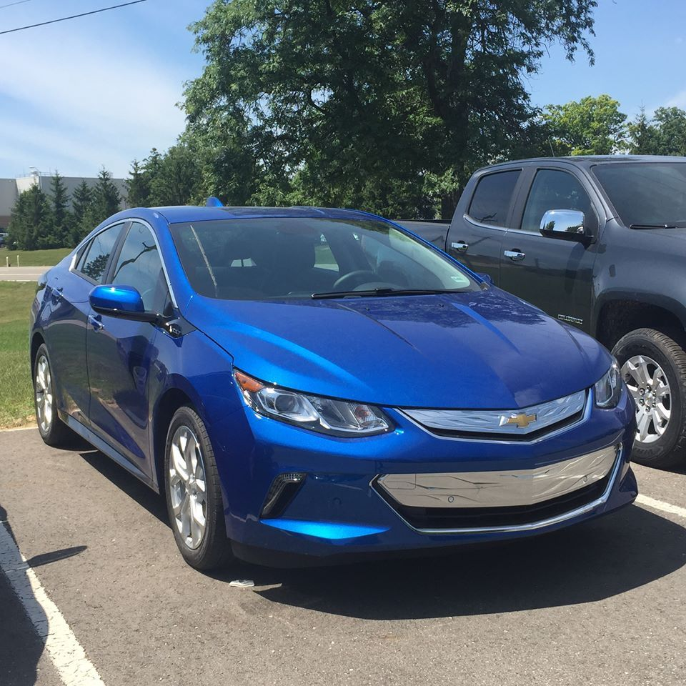
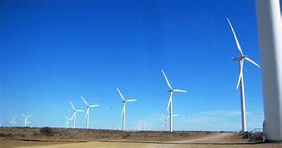
Building Blocks for a Green New Deal
100% Clean Economy Act
of 2019
Driving America Forward Act H.R. 2256/S.1094

Slide 14
100% Clean Economy Act of 2019
Set a National Goal to Achieve a 100% Clean Economy by 2050
Net-zero climate pollution across the U.S. Economy
Replace carbon-polluting energy with wind, solar, and other clean sources of energy
Across all sectors
Making no more pollution than we can remove

Slide 15
100% Clean Economy Act of 2019
Immediate Action Using Existing Authorities
Regulations
Incentives
Research and Development
Technology-neutral

Slide 16
100% Clean Economy Act of 2019
Immediate Action Using Existing Authorities
Make vehicles more efficient
Cut methane emissions
Increase energy efficiency standards
Clean procurement inside government agencies

Slide 17
100% Clean Economy Act of 2019
Guiding Principles
Improve health, resilience, and environmental outcomes for all, especially the most vulnerable
Consumers, small businesses, rural communities
Job creation, transitional programs
Prepare for climate impacts

Slide 18
100% Clean Economy Act of 2019
Accountability
EPA to evaluate all agency plans
Make recommendations if needed
Report every year about progress toward net-zero by 2050

Slide 19
100% Clean Economy Act of 2019
Advisory Committee
Public and Expert Input
Broad range of stakeholders
Non-governmental authorities
Complement Green New Deal
Same net-zero by 2050
Environmental justice goals
Needs interim goals
Should be introduced this fall

Slide 20
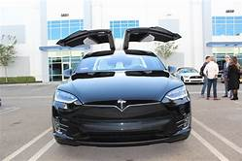
Driving America Forward Act H.R. 2256/S.1094
Transportation is the largest source of pollution.
We need more green cars on our roads
Bolster the EV tax credit

Slide 21
Driving America Forward Act H.R. 2256/S.1094
Provides consumers with a $7000 Tax credit when they purchase an electric vehicle
Expand existing EV tax credit for 200,000 EVs per automaker to 600,000

Slide 22
Driving America Forward Act H.R. 2256/S.1094
Benefits
Helps working families
Reduce Green House Gases
Create American Jobs (not sure)
Save Consumers Money

Slide 23
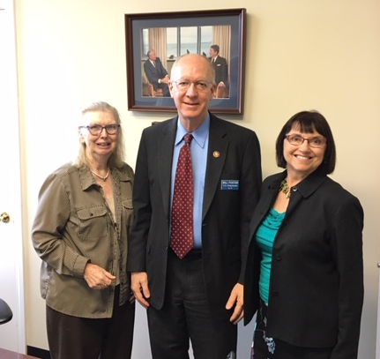
Next Steps
It’s time to lobby your congressman or congresswoman
Introduce them to these bills
Get their feedback

Slide 24
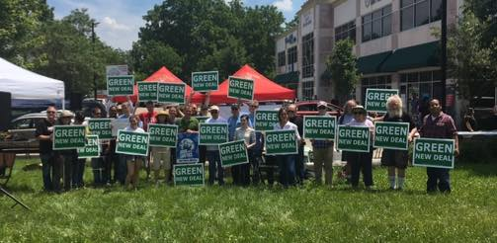
It’s Time!
We are laying the groundwork for the most important fight of our lives. And we can start today!

Slide 25
It’s Time!
For more information or for help with lobbying your congressman or congresswoman, please contact me.
Mavis Bates
mavis@myinnerharmony.com
630-605-9244

Slide 26
A Green New Deal

